Slide 1








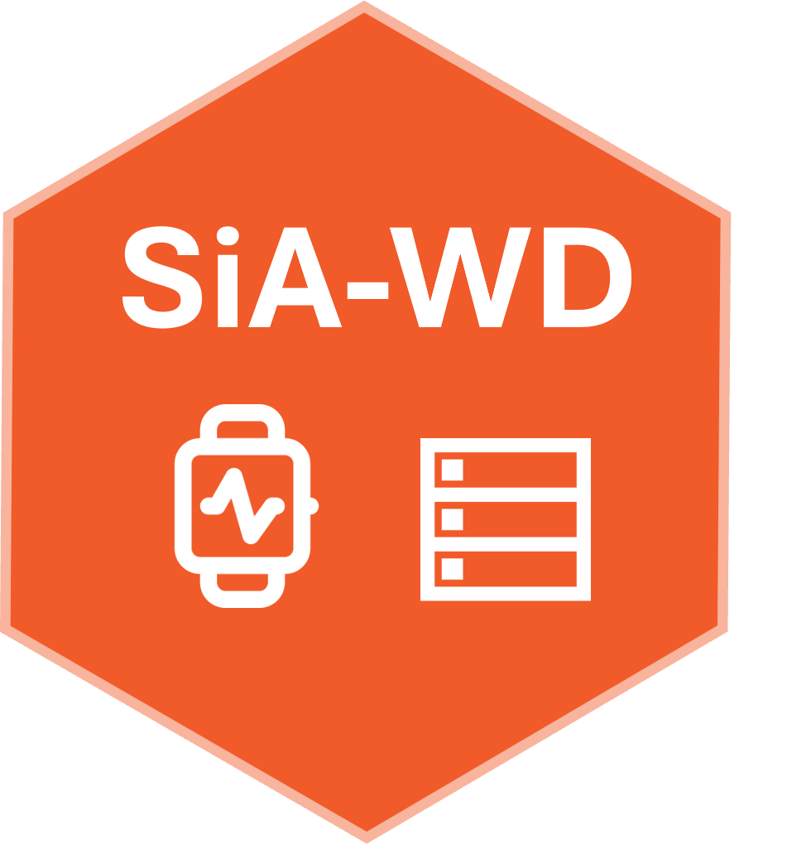




DISC Wearable Relational Database Pipeline
1. Key-ID’s
2. Merge
3. Wrangle
4. Create
5. Publish
www
Local
GitHub repo: https://github.com/HugoGit39/sia.project.1.wd.data

